Slide 1
graudit
HITB Cyberweek armory 2019

Slide 2

`whoami`
Proven history of performing security research that result in 0day vulnerabilities, conference presentation and security tools. I have written a source code scanner and auditing source code is often part of my security research process. My past research and security tools have also featured in industry related cyber security text books.
Developer
Husband and Father
Eldar Marcussen
Lead security researcher
A former
System administrator
Currently
Security researcher
Penetration tester
Trainer

Slide 3
graudit

Slide 4

graudit
graudit is a simple script and signature sets that allows you to find potential security flaws in source code using the GNU utility grep.
It's comparable to other static analysis applications like RATS, SWAAT and flaw-finder while keeping the technical requirements to a minimum and being very flexible.
4

Slide 5
Bug hunting with graudit
FAST
SIMPLE
SCRIPTABLE
PROVEN
5

Slide 6
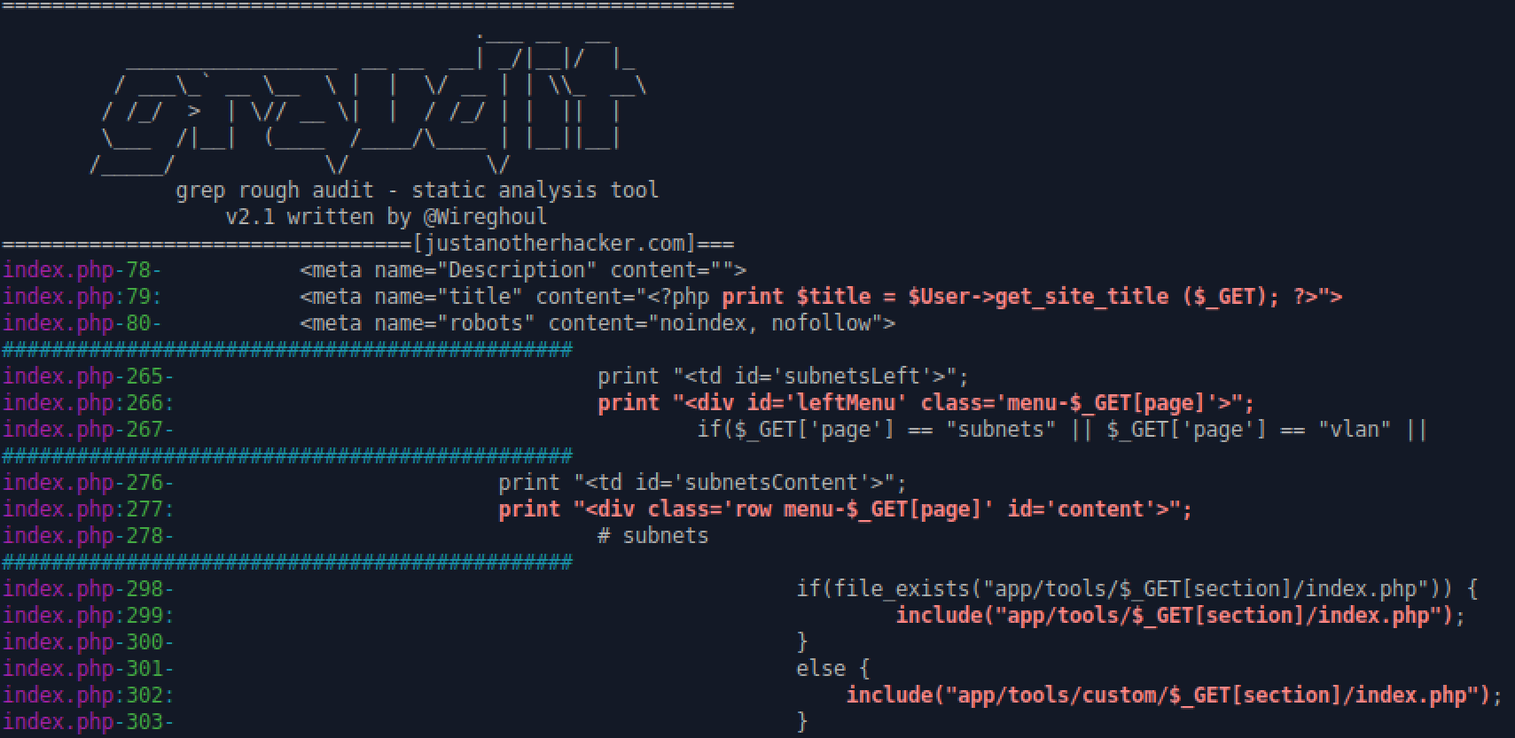
6

Slide 7
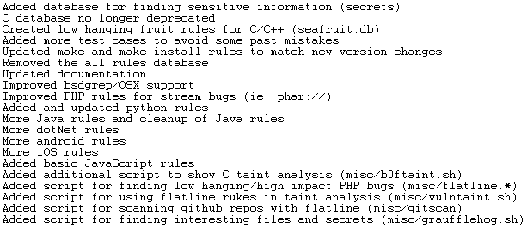
What’s new?
Notes:
HAS TYPO (RUKES/RULES)

Slide 8
W
STATIC SOURCE CODE ANALYSIS TOOLS
https://github.com/mre/awesome-static-analysis
https://www.owasp.org/index.php/Source_Code_Analysis_Tools
GREP
TOOLS CANNOT FIND SOME TYPES OF VULNERABILITIES
HUMAN ANALYSIS IS REQUIRED
8

Slide 9
Custom rulesets

Slide 10

Rules/Regular expressions
require
require\(.*\$.*\);
(require|require_once)\(.*\$.*\);
require(_once)?[[:space:]]*(\(|\’\”).*\$_(GET|POST|REQUEST|ENV|COOKIE).*(\)|\’|\”)\;
10

Slide 11
Wordpress rules
_weak_escape
_do_query
\$_(GET|POST|REQUEST|COOKIE|SERVER)
\$[^\,\;\(\> ]+\->prepare[[:space:]]*\(.*\$.*
\$[^\,\;\(\> ]+\->get_(row|col|var|results).*\$.*
\$[^\,\;\(\> ]+\->get_param.*\$.*
\$[^\,\;\(\> ]+\->get_body_param.*\$.*
\$[^\,\;\(\> ]+\->get_header.*
\$[^\,\;\(\> ]+\->get_json_params.*
\$[^\,\;\(\> ]+\->get_file_params.*
\$[^\,\;\(\> ]+\->get_query_param.*
11

Slide 12
SQL injection
query[[:space:]]*\(.*\$_(GET|POST|REQUEST|COOKIE)\[
[Ss][Ee][Ll][Ee][Cc][Tt].*\$_(GET|POST|REQUEST|COOKIE)\[.*[Ff][Rr][Oo][Mm]
[Ss][Ee][Ll][Ee][Cc][Tt].*[Ff][Rr][Oo][Mm].*\$_(GET|POST|REQUEST|COOKIE)\[
[Ww][Hh][Ee][Rr][Ee].*=.*\$_(GET|POST|REQUEST|COOKIE)\[
([Aa][Nn][Dd]|[Oo][Rr]).*=.*\$_(GET|POST|REQUEST|COOKIE)\[
12

Slide 13
Custom scripts

Slide 14
Quickly build custom scripts
#!/bin/sh
echo “function.*__(wakeup|destruct|autoload)[:space:]]*\\(“ | \
graudit –x *.js -d - -- -A 20 $1 | \
graudit –c 30 -d php -
14

Slide 15
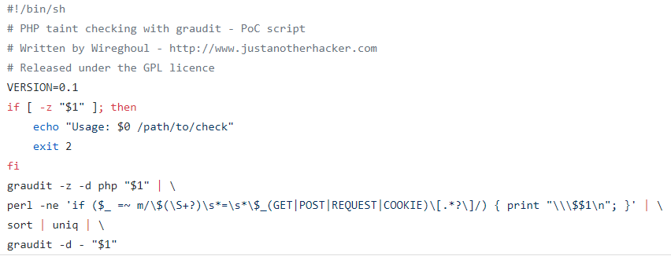
Taint analysis with grep
15

Slide 16
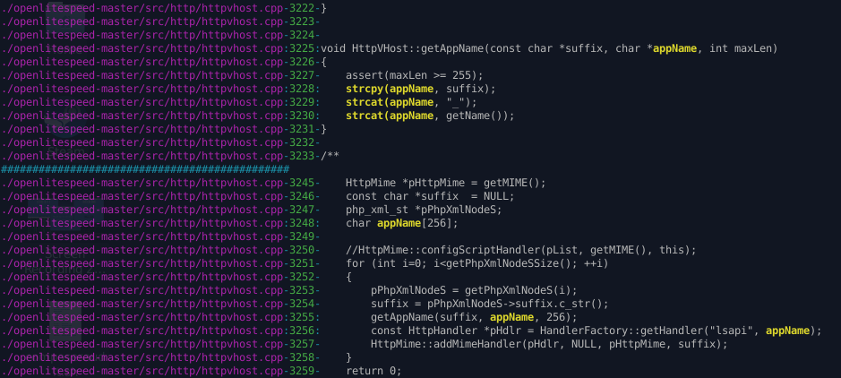
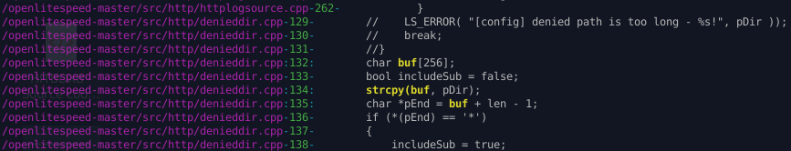
Buffer overflow
#!/bin/sh
VERSION=0.1
if [ -z "$1" ]; then
echo "Usage: $0 /path/to/check“
exit 2
Fi
echo 'char[[:space:]]+[a-zA-Z0-9\.\-\_][a-zA-Z0-9\.\-\_]+\[' | ~/flatline/graudit -B -z -d - "$1" | \
perl -ne 'if ($_ =~ m/char\s+([a-zA-Z0-9\.\-\_]+)\[/) {
@rulz=(
"strc(at|py)[[:space:]]*\\(",
"sprintf[[:space:]]*\\(“,
);
print "$1\n" . join("\n", map $_."$1", @rulz) . "\n";
}' | \sort | uniq | \~/flatline/graudit -c 3 -B -d - "$1"
16

